Slide 2
As you come to him, a living stone rejected by [humans] but in the sight of God chosen and precious, you yourselves like living stones are being built up as a spiritual house, to be a holy priesthood, to offer spiritual sacrifices acceptable to God through Jesus Christ. For it stands in Scripture:
“Behold, I am laying in Zion a stone,
a cornerstone chosen and precious,
and whoever believes in him will not be put to shame.”
1 Peter 2:4-6, ESV

Slide 3
WELCOME
&
INVITATION
*In the following four weeks of worship, you are invited to find a stone you can hold, to be included as part of your worship.*
As you come to him, a living stone rejected by humans but in the sight of God chosen and precious…
We, like living stones, are being built up as a spiritual house, to be a holy priesthood, to offer spiritual sacrifices acceptable to God.

Slide 4
WELCOME
&
INVITATION
Our lives are oftentimes fast paced and we are called in many different directions that compete for our time, attention, and resources. Too often the noises of our “modern” world inhibit our ability to hear the call from the Good Shepherd, to hear the call of Jesus and how he leads us to be engaged in the world. We choose to remain behind our known walls.
*While holding your stone, think about what drowns out or distracts you from hearing the call to follow.*

Slide 5
CALL TO WORSHIP
We gather together in the presence of our Shepherd God.
The One who calls us each by name, who restores our souls, and leads us in the way of righteousness.
God’s goodness and love never stop pursuing us.
This is the God we have come to worship!

Slide 6
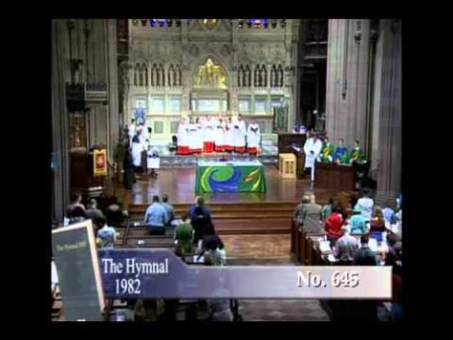
THE KING OF LOVE MY SHEPHERD IS
Glory to God #802

Slide 7
CALL TO CONFESSION
We confess together as a community of faith because we acknowledge the reality of sin in the church, the world, and our personal lives, and so we ask God for forgiveness and help in amending our lives. And the proof of God’s amazing love is this: while we were sinners Christ died for us. Because we have faith in him, we dare to approach God with confidence, assured of a forgiveness already given through Christ.

Slide 8
PRAYER OF CONFESSION
Lord, have mercy on us. We talk about love, but our actions betray us. We talk about love, but we neglect the poor. We talk about love, but we fail to love one another. Lord, have mercy on us. Forgive us, and abide in us by the power of your Spirit so that our lives may show our love for Jesus Christ, in whose body we live and in whose name we pray. Amen.
Liturgy provided from Feasting on the Word Worship Companion - Reprinted by permission of Westminster John Knox Press from Feasting on the Word: Liturgies for Year A, Volume 1. Copyright 2013.

Slide 9
ASSURANCE OF PARDON
Friends, hear the good news! Who is in a position to condemn? Only Christ, and Christ died for us, Christ rose for us, Christ reigns in power for us, Christ prays for us. Anyone who is in Christ is a new creation. The old life has gone; a new life has begun. Know that we are forgiven and be at peace.
Amen.

Slide 10
PRAYER FOR ILLUMINATION
Lord God, Good Shepherd, by the leading of your Spirit, help us to listen for your voice and follow in your paths all the days of our lives; in Jesus’ name. Amen.
Liturgy provided from Feasting on the Word Worship Companion - Reprinted by permission of Westminster John Knox Press from Feasting on the Word: Liturgies for Year A, Volume 1. Copyright 2013.

Slide 11
SCRIPTURE
John 10:1-10
‘Very truly, I tell you, anyone who does not enter the sheepfold by the gate but climbs in by another way is a thief and a bandit. The one who enters by the gate is the shepherd of the sheep. The gatekeeper opens the gate for him, and the sheep hear his voice. He calls his own sheep by name and leads them out. When he has brought out all his own, he goes ahead of them, and the sheep follow him because they know his voice.

Slide 12
SCRIPTURE
John 10:1-10
They will not follow a stranger, but they will run from him because they do not know the voice of strangers.’ Jesus used this figure of speech with them, but they did not understand what he was saying to them.
So again Jesus said to them, ‘Very truly, I tell you, I am the gate for the sheep. All who came before me are thieves and bandits; but the sheep did not listen to them. I am the gate.

Slide 13
SCRIPTURE
John 10:1-10
Whoever enters by me will be saved, and will come in and go out and find pasture. The thief comes only to steal and kill and destroy. I came that they may have life, and have it abundantly.

Slide 14
MESSAGE

Slide 15
*Find a place and lay down your stone, your distractions,
into God’s keeping now.*

Slide 16
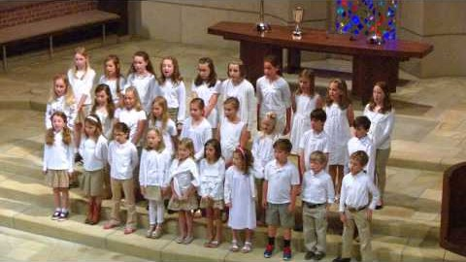
GOD IS CALLING THROUGH THE WHISPER
Glory to God #410

Slide 17
PRAYERS OF THE PEOPLE
God who exists without bounds or limits, you call us to confidently live the same way, but fears and worries about scarcity and discomfort slow us, even stop us. In this Easter season especially, help us remember the ways our risen Christ lived - fully trusting in you, undaunted by the unknown. Grant us a measure of courage each day, that we might live and love more expansively than we did the day before.

Slide 18
PRAYERS OF THE PEOPLE
God, when challenges are in front of us, too often we doubt our ability to lean into them or find the emotions bigger than we think we can bear. We forget that we are not solitary beings, but are surrounded by clouds of witnesses who have trod similar paths, seen similar difficulties, carried similar burdens. Most of all we forget that you go with us, calling us into what is next, beckoning as one who goes before us, behind us, and alongside us. Help us to remember your presence which never leaves us alone.

Slide 19
PRAYERS OF THE PEOPLE
God, we pray your tangible, clear presence with all who know fear, with all who seek health, with all who will die, with all who feel lost, with those whose tears have run dry and those whose tears will not stop. Send your Spirit of comfort upon all those facing days and nights which feel difficult and heavy and long, we pray, that they might experience peace. Amen.

Slide 20
OFFERING
We build walls around us to create the sense of safety: personal safety, emotional protection, financial security. The Good Shepherd, however, only allows us to stay behind those walls for a short time; he calls us out, one by one, knowing we can only experience abundant life once we go beyond the walls and into the green pastures. In gratitude for that promise of abundance, please consider giving online or by check this week.

Slide 21
INVITATION TO COMMUNION & THE GREAT THANKSGIVING
The Lord be with you!
And also with you.
Lift up your hearts.
We lift them up to the Lord.
Let us give thanks to the Lord our God.
It is right to give our thanks and praise.

Slide 22
THE GREAT THANKSGIVING (CONT’D)
…Therefore, we join our voices with all creation and all ages to proclaim the glory of your name:
Holy, holy, holy Lord, God of power and might, heaven and earth are full of your glory. Hosanna in the highest! Blessed is he who comes in the name of the Lord. Hosanna in the highest!

Slide 23
THE LORD’S PRAYER
Our Father, who art in heaven, hallowed be thy name.
Thy kingdom come, thy will be done, on earth as it is in heaven.
Give us this day our daily bread;
and forgive us our debts, as we forgive our debtors;
and lead us not into temptation, but deliver us from evil.
For thine is the kingdom and the power and the glory, forever. Amen.

Slide 24
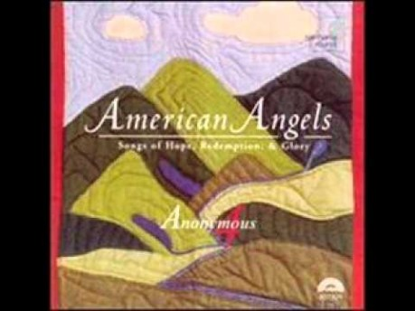
MY SHEPHERD WILL SUPPLY MY NEED
Glory to God #803

Slide 25
CHARGE & BENEDICTION
Though we find our safety behind walls, the walls of our homes, the walls of our churches, the Good Shepherd will call us out to experience the green pastures that lay beyond stone walls. Go experience the promise of abundant life and to proclaim it to all who will listen. May the Lord bless you and keep you; may the Lord’s face shine upon you and be gracious to you; and may the Lord turn toward you and give you peace.

