Slide 2
Now you are coming to him as to a living stone. Even though this stone was rejected by humans, from God’s perspective it is chosen, valuable. You yourselves are being built like living stones into a spiritual temple. You are being made into a holy priesthood to offer up spiritual sacrifices that are acceptable to God through Jesus Christ. Thus it is written in scripture, Look! I am laying a cornerstone in Zion, chosen, valuable. The person who believes in him will never be shamed.
1 Peter 2:4-6, CEB

Slide 3
WELCOME
&
INVITATION
*In the following three weeks of worship, you are invited to find a stone you can hold, to be included as part of your worship.*
Now you are coming to him as to a living stone. Even though this stone was rejected by humans, from God’s perspective it is chosen, valuable.
We ourselves are being built like living stones into a spiritual temple. We are being made into a holy priesthood to offer up spiritual sacrifices that are acceptable to God through Jesus Christ.

Slide 4
WELCOME
&
INVITATION
Jesus reminds us that in God’s house there are many rooms, there is much space, and that God’s kingdom includes and welcomes all. We are called out into the world to continue building and expanding the reign of God which has no limits.
*While holding your stone, think about how you as an individual or as a community of faith can build upon God’s expanding reign.*

Slide 5
CALL TO WORSHIP
Jesus said, I go and prepare a place for you, and I will come again.
We gather in this place to know your presence and your love.
Jesus said, I am the Way, and the Truth, and the Life. If you know me, you know God.
We pray to know you more deeply, that we may know God more intimately.

Slide 6
CALL TO WORSHIP
Jesus said, in God’s house there are many rooms, there are many places where God dwells on earth.
We search to know God out in the world, to engage more deeply and love more thoroughly.
Let us begin by, together, worshipping God in this place and at this time.

Slide 7
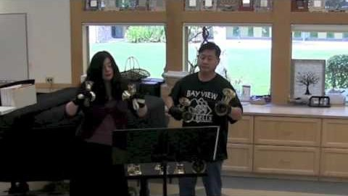
SING PRAISE TO GOD WHO REIGNS ABOVE
Glory to God #645

Slide 8
CALL TO CONFESSION
We confess together as a community of faith because we acknowledge the reality of sin in the church, the world, and our personal lives, and so we ask God for forgiveness and help in amending our lives. And the proof of God’s amazing love is this: while we were sinners Christ died for us. Because we have faith in him, we dare to approach God with confidence, assured of a forgiveness already given through Christ.

Slide 9
PRAYER OF CONFESSION
God of mercy, we confess that we have not borne the fruit of the Spirit. We have not loved others as you have loved us. We have denied the promises of baptism and cut ourselves off from you. Forgive us, restore us, that we may abide in your love and live out your mercy, for the sake of Jesus Christ, in whose name we pray. Amen.
Liturgy provided from Feasting on the Word Worship Companion - Reprinted by permission of Westminster John Knox Press from Feasting on the Word: Liturgies for Year A, Volume 1. Copyright 2013.

Slide 10
ASSURANCE OF PARDON
Friends, hear the good news! Who is in a position to condemn? Only Christ, and Christ died for us, Christ rose for us, Christ reigns in power for us, Christ prays for us. Anyone who is in Christ is a new creation. The old life has gone; a new life has begun. Know that we are forgiven and be at peace.
Amen.

Slide 11
PRAYER FOR ILLUMINATION
Come, Holy Spirit, that through your word we may be guided into the love of God for all the world. Amen.
Liturgy provided from Feasting on the Word Worship Companion - Reprinted by permission of Westminster John Knox Press from Feasting on the Word: Liturgies for Year A, Volume 1. Copyright 2013.

Slide 12
SCRIPTURE
John 14:1-4
‘Do not let your hearts be troubled. Believe in God, believe also in me. In my Father’s house there are many dwelling-places. If it were not so, would I have told you that I go to prepare a place for you? And if I go and prepare a place for you, I will come again and will take you to myself, so that where I am, there you may be also. And you know the way to the place where I am going.’

Slide 13
MESSAGE

Slide 14
*Find a place and lay down your stone, the way you can share in expanding God’s reign, to share with God, into God’s keeping now.*

Slide 15
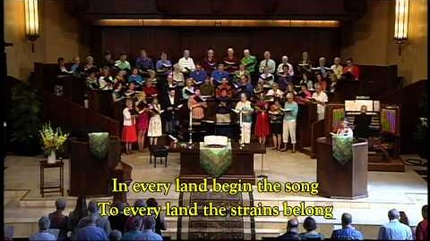
FROM ALL THAT DWELL BELOW THE SKIES
Glory to God #327

Slide 16
PRAYERS OF THE PEOPLE
God, we have gotten comfortable with our own four walls, whether they be the walls of our homes or the walls of our churches. It’s possible we’ve even become accustomed to our isolation, finding new routines which placate us. Stir us from our cocoons, from our fortresses, from our hiding places to remember that there are others outside the walls. There are others who have been impacted disproportionately because of their income or lack thereof, because of the color of their skin, because of systems that left them with no

Slide 17
PRAYERS OF THE PEOPLE
passed-on wealth, no safety net, poorer health before the virus even began. Open our eyes to see these siblings of ours, to see clearly the disadvantages that were set up and reinforced and bolstered generations ago, which must be broken down and discarded in place of systems which bring equity and health and enough for all. Stir us to strive for better than the way it was before we were safer-at-home, for the sake of all your children.

Slide 18
PRAYERS OF THE PEOPLE
God of beauty, in these recent weeks we have relied on the beauty of the arts to give us relief, in storytelling and visual arts and television and movies and music and baking and cooking and dance. Help us go beyond appreciating them for the solace, and even happiness, they brought and move us to demand equity and health and enough for all who made these forms of beauty possible, for our world is surely richest when there are arts. And we don’t want to forget that. Help us to not forget that, we pray.

Slide 19
PRAYERS OF THE PEOPLE
God of this world, show us the ways we can work for the good of all your people even when we are contained within our walls. Spur us to continue serving in your name even while we await the time to be freely outside walls and doing your work from there. We ask all of these things through Christ, who taught us to pray, saying:

Slide 20
THE LORD’S PRAYER
Our Father, who art in heaven, hallowed be thy name.
Thy kingdom come, thy will be done, on earth as it is in heaven.
Give us this day our daily bread;
and forgive us our debts, as we forgive our debtors;
and lead us not into temptation, but deliver us from evil.
For thine is the kingdom and the power and the glory, forever. Amen.

Slide 21
OFFERING
When we receive your offering, we often talk about how it will be used for the sustaining of the church - our ministries, our worship, and the building. The house that God builds, however, is not limited to this building. With thanksgiving that God is preparing rooms to receive all nations, we make gifts with joyous hearts. Please consider giving online or by check this week.

Slide 22
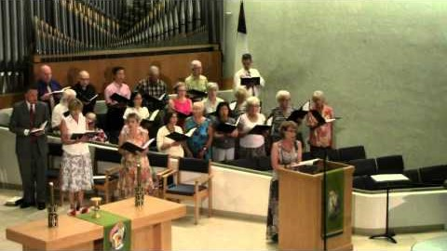
O CHRIST, THE GREAT FOUNDATION
Glory to God #361

Slide 23
CHARGE & BENEDICTION
We have joined with Christians around the world this day to worship God: in sanctuaries, in houses, under shade trees and thatched roofs, and in grand cathedrals. God’s house has many rooms, and it is still not full. Go now into the world, ready to find God in the most unlikely places. Go now with confidence that there is a room - a place of love - reserved especially for you.

