Slide 2
Come to him, a living stone, though rejected by mortals yet chosen and precious in God’s sight, and like living stones, let yourselves be built into a spiritual house, to be a holy priesthood, to offer spiritual sacrifices acceptable to God through Jesus Christ. For it stands in scripture:
“See, I am laying in Zion a stone,
a cornerstone chosen and precious;
and whoever believes in him will not be put to shame.”
1 Peter 2:4-6, NRSV

Slide 3
WELCOME
&
INVITATION
*In these next six weeks of worship, you are invited to find a stone you can hold, to be included as part of your worship.*
Come to him, a living stone, though rejected by mortals yet chosen and precious in God’s sight.
Like living stones, let us be built into a spiritual house; a holy priesthood.

Slide 4
WELCOME
&
INVITATION
Doubt is natural part of faith. It helps us to deepen our relationship with God and encourages us to ask “hard” questions. What can weigh us down and become a barrier is the fear that we carry. We often become immobilized by our fear and are unable to perceive Christ’s movement in our life.
*While holding your stone, think about those times in your life you have let fear be your guide.*

Slide 5
CALL TO WORSHIP
Let us rejoice! The risen Christ is among us and greets us with the message of Peace!
Like the disciples, we rejoice at the good news! Like the disciples, we also have our doubts.
Jesus said, “Blessed are those who have not seen and yet have come to believe.”
Open our hearts, O God, so that we too may have faith and not feel weighed down by our doubt!
The risen Christ invites us to receive the Holy Spirit and to share the Good News.
Let us be filled with the spirit and embrace the peace of Christ.

Slide 6
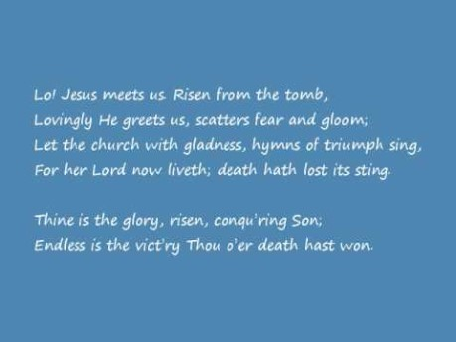
THINE IS THE GLORY
Glory to God #238

Slide 7
CALL TO CONFESSION
We confess together as a community of faith because we acknowledge the reality of sin in the church, the world, and our personal lives, and so we ask God for forgiveness and help in amending our lives. And the proof of God’s amazing love is this: while we were sinners Christ died for us. Because we have faith in him, we dare to approach God with confidence, assured of a forgiveness already given through Christ.

Slide 8
PRAYER OF CONFESSION
You have shown yourself to us, O God, by Word and Spirit, with signs and wonders, in flesh and blood, yet we still struggle to live and believe the good news of Jesus Christ. Have mercy on us; forgive us. Enter into our lives and cast out our fear so that we may come to trust in you and have life in Jesus’ name. Amen.
*Find a place and lay down your stone, your fears, into God’s keeping now.*
Liturgy provided from Feasting on the Word Worship Companion - Reprinted by permission of Westminster John Knox Press from Feasting on the Word: Liturgies for Year A, Volume 1. Copyright 2013.

Slide 9
ASSURANCE OF PARDON
Friends, hear the good news! Who is in a position to condemn? Only Christ, and Christ died for us, Christ rose for us, Christ reigns in power for us, Christ prays for us. Anyone who is in Christ is a new creation. The old life has gone; a new life has begun. Know that we are forgiven and be at peace.
Amen.

Slide 10
PRAYER FOR ILLUMINATION
God of all who doubt and believe, by the gift of your Spirit enable us to hear with our ears, to see with our eyes, and to touch with our hands your Word of life - Jesus Christ - our Lord and our God. Amen.
Liturgy provided from Feasting on the Word Worship Companion - Reprinted by permission of Westminster John Knox Press from Feasting on the Word: Liturgies for Year A, Volume 1. Copyright 2013.

Slide 11
SCRIPTURE
John 20:19-31
When it was evening on that day, the first day of the week, and the doors of the house where the disciples had met were locked for fear of the Jews, Jesus came and stood among them and said, ‘Peace be with you.’ After he said this, he showed them his hands and his side. Then the disciples rejoiced when they saw the Lord. Jesus said to them again, ‘Peace be with you. As the Father has sent me, so I send you.’ When he had said this, he breathed on them and said to them, ‘Receive the Holy Spirit.

Slide 12
SCRIPTURE
John 20:19-31
If you forgive the sins of any, they are forgiven them; if you retain the sins of any, they are retained.’
But Thomas (who was called the Twin), one of the twelve, was not with them when Jesus came. So the other disciples told him, ‘We have seen the Lord.’ But he said to them, ‘Unless I see the mark of the nails in his hands, and put my finger in the mark of the nails and my hand in his side, I will not believe.’

Slide 13
SCRIPTURE
John 20:19-31
A week later his disciples were again in the house, and Thomas was with them. Although the doors were shut, Jesus came and stood among them and said, ‘Peace be with you.’ Then he said to Thomas, ‘Put your finger here and see my hands. Reach out your hand and put it in my side. Do not doubt but believe.’ Thomas answered him, ‘My Lord and my God!’ Jesus said to him, ‘Have you believed because you have seen me? Blessed are those who have not seen and yet have come to believe.’

Slide 14
MESSAGE

Slide 15
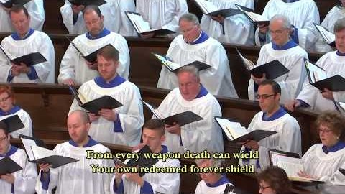
THAT EASTER DAY WITH JOY WAS BRIGHT
Glory to God #254

Slide 16
PRAYERS OF THE PEOPLE
God of mercy, we are afraid. We are afraid for our loved ones, for our neighbors and our communities, our nation and all nations, for ourselves. Help us to honor the feeling of fear without becoming paralyzed by it, without becoming hardened, without turning inward because of it. In life and in death we belong to you, made certain by Jesus’ resurrection, so fresh in our minds. Send your Spirit to fill us with courage that is bigger than fear, that we might be holders and carriers and sharers of hope in you.

Slide 17
PRAYERS OF THE PEOPLE
God of tenderness, we pray your presence with healthcare workers who have seen and who have experienced painful and haunting things in the midst of their struggles to be restorers of health. Comfort them in their grief as you comfort all who have been touched by death, which comes in many forms. Give us the strength to be those upon whom they can lean, to be those who can listen.

Slide 18
PRAYERS OF THE PEOPLE
God of green things, around us the world still shows signs of life as it has done spring after spring for millennia. Open our eyes that we might receive the miracle of small, new leaves, the miracle of the flight of birds and butterflies, the miracle of kindnesses in small gestures. May we see the evidences of goodness and, even more so, may we be the evidence of goodness, we pray. We ask all of these things through Christ, who taught us to pray, saying:

Slide 19
THE LORD’S PRAYER
Our Father, who art in heaven, hallowed be thy name.
Thy kingdom come, thy will be done, on earth as it is in heaven.
Give us this day our daily bread;
and forgive us our debts, as we forgive our debtors;
and lead us not into temptation, but deliver us from evil.
For thine is the kingdom and the power and the glory, forever. Amen.

Slide 20
OFFERING
Thomas found himself weighed down by doubt. He insisted on proof before he could believe. Sometimes we experience the same doubt when given the opportunity to make our offering. We question what expenses might come our way and whether we can afford to be generous. We ask how the money will be used and whether it will make a difference. You are invited to set aside the weight of those doubts and experience the joy of trusting in the goodness of the Lord to sustain us. Please consider giving online or by check this week.

Slide 21

WE WALK BY FAITH AND NOT BY SIGHT
Glory to God #817

Slide 22
CHARGE & BENEDICTION
The world is full of Doubting Thomases. Know that this is a weighty burden they carry. Your call is to help share the load, not because you have all the answers, but because you are willing to struggle with them over the questions. Go in confidence that you are loved by God, covered by the grace of our Lord, Jesus Christ, and empowered by the Holy Spirit.

